Slide 1
Vue.js
Group Members:
Adithya Reddy
Sravya Kotwal
Keerthana Reddy
Saranya Chakravarthy Korrapati
Akhil Nakka
Samuel Sowpathi
Balaji Ganesan Greeshma Koneru Nohith Challa

Slide 2
Contents
Introduction to Vue.js
Features of Vue.js
Setting up Vue.js Project
Vue.js Directives
Data Binding
Component Structure
Vue.js Routes
Vue.js vs Angular
Integrating Vue.js with Spring Boot
Conclusion
References

Slide 3
Introduction to Vue.js
Vue is a JavaScript framework for building user interfaces.
It builds on top of standard HTML, CSS, and JavaScript and provides a declarative, component-based programming model that helps you efficiently develop user interfaces of any complexity.
Vue.js lets you extend HTML with HTML attributes called directives.
Vue.js directives offer functionality to HTML applications
Vue.js provides built-in directives and user-defined directives

Slide 4
Features of Vue.js
Declarative Rendering: Vue extends standard HTML with a template syntax that allows us to declaratively describe HTML output based on JavaScript state.
Reactivity: DOM is dynamically updated by Vue's reactivity system in response to changes in the underlying data. Which is accomplished by employing its reactive declarations and data property.
Component-Based Architecture: Reusable and encapsulated components are assembled to construct applications. It is possible for each component to possess its own JS, CSS, and HTML logic.
Seamless Handling: The v-model directive facilitates the seamless processing of forms and input by facilitating two-way synchronization between the data and the view.
Reactive State Mgmt: Vue offers Vuex, a centralized state management library that enables the sharing of state between components.
Custom Events: To facilitate communication between parent and offspring components, Vue permits components to emit custom events.
Routing: Vue Router enables dynamic page changes without reloading, thereby facilitating navigation and routing in single-page applications.

Slide 5
Setting up a Vue.js project
We can set up a Vue.js project from the CLI
First Node.js and npm are installed using the commands:
Node –v
Npm –v
Next Vue CLI is installed globally using npm install –g @vue/cli
Create a new Vue-js project using the command: vue create <project-name>
When attempting to create a project Vue will prompt the default setup(Babel, ESLint), and ask the user to select additional features like Vuex, TypeScript, Router, .etc
Change the working directory to your project and run the server using: npm run serve
Finally, open the app in the browser under local host port 8080.

Slide 6
Vue.js Directives
v-bind: For dynamically binding attributes to a value
<img v-bind:src="imageUrl" alt="Dynamic Image">
v-model: This enables two-way binding b/w form inputs and component data
<input v-model="name" placeholder="Enter your name">
<p>{{ name }}</p>
v-for: This renders a list of items by using a for loop:
<ol>
<li v-for="(item, index) in items" :key="index">{{ item }}</li>
</ol>
v-once: Only one instance of the element and its offspring is produced. This element will not be updated in response to modifications to the data.
<p v-once>{{ message }}</p>
v-cloak: Utilized with CSS to conceal raw mustache elements until Vue completes compilation
<style>
[v-cloak] { display: none; }
</style>
<div v-cloak>{{ message }}</div>

Slide 7
Data Binding
One-Way Data Binding: {{ }} is used for text interpolation and v-bind (or :) is utilized for dynamic attributes like src, href, or class.
Two-Way Data Binding: v-model used for form inputs (e.g., <input> ) to sync data between the DOM and Vue instance.
v-bind is used for one-way binding for attributes, whereas v-model is used for two-way binding for user input.
The UI is updated efficiently by Vue using the virtual DOM in response to changes.
Classes and inline styles can be binded using:
<div :class="{ active: isActive }"></div>
<div :style="{ color: textColor, fontSize: fontSize + 'px' }"></div>
Dynamic Property Binding: Properties of components or elements are dynamically bound.
<component :is="currentComponent"></component>

Slide 8
Component Structure
.vue files are usually used to build a Vue.js component in a Single File Component (SFC) format. The template, script, and style parts are all put together in one file.
<template>: The HTML layout of the component is set.
It needs to be inside a <template> tag. You can only have one root part.
<script>: It has the component's JavaScript code in it.
This is where you define data, methods, computed properties, and lifecycle hooks.
Included inside the <script> tag.
<style>: Gives the component its CSS styles.
Included inside the <style> tag.
If you only want to style this component, use the scoped property.

Slide 9
Vue.js Routes
The main routing library for Vue.js is Vue Router, which lets you make single-page apps (SPAs) with dynamic navigation.
Vue router is installed using: npm install vue-router
Routes are created in the router/index.js file. Eg:
const routes = [ { path: '/', component: Home }, { path: '/about', component: About }, ];
Router is registered using: app.use(router);
Routes can be used in components:
<router-view>: Renders the matched component.
<router-link>: Used for navigation.
In order to navigate programmatically we use: this.$router.push('/about’);
Additionally, dynamic routes can be included in our project by using the syntax:
{ path: '/user/:id', component: User } and accessed as this.$route.params.id;

Slide 10
Vue.js Vs Angular
Key differences are as follows:
Feature | Vue.js | Angular
Data binding | 2-way binding (simple syntax) | 2-way binding (more structured)
Directives | Simple(v-bind, v-once, v-cloak) | Complex(*ngFor,*ngIf)
State Mgmt. | Vuex which is lightweight | RxJS and Services
Routing | Vue router | Angular router which is more advanced
Templates | HTML with directives | HTML with TypeScript logic

Slide 11
Integrating Vue.js with Spring Boot
Make a Spring Boot Project: To make a project with requirements like these, use Spring Initializer.
Spring Web is used for REST APIs.
You don't have to use Spring Boot DevTools to do work.
Next, create REST APIs and then start the server on 8080
Create a Vue.js project to set up the frontend using npm install and vue create commands.
Axios is then installed for the HTTP client to make API calls.
API calls are then made to Spring Boot. Check the example App.vue.
<template>
<div>
<h1>{{ message }}</h1>
</div>
</template>
<script>
import axios from 'axios';
export default {
data() {
return { message: "" };
},
mounted() {
axios.get("http://localhost:8080/api/hello")
.then(response => this.message = response.data)
.catch(error => console.error(error));
}
};
</script>

Slide 12
Integrating Vue.js with Spring Boot
The Vue server is then run on 8081 by default using the npm run serve
The Vue project is then built using:
npm run build
The above command creates a dist folder. Move the Vue dist folder to your Spring Boot app's src/main/resources/static path.
Finally, the Vue app will be served from the same server after you run Spring Boot.

Slide 13
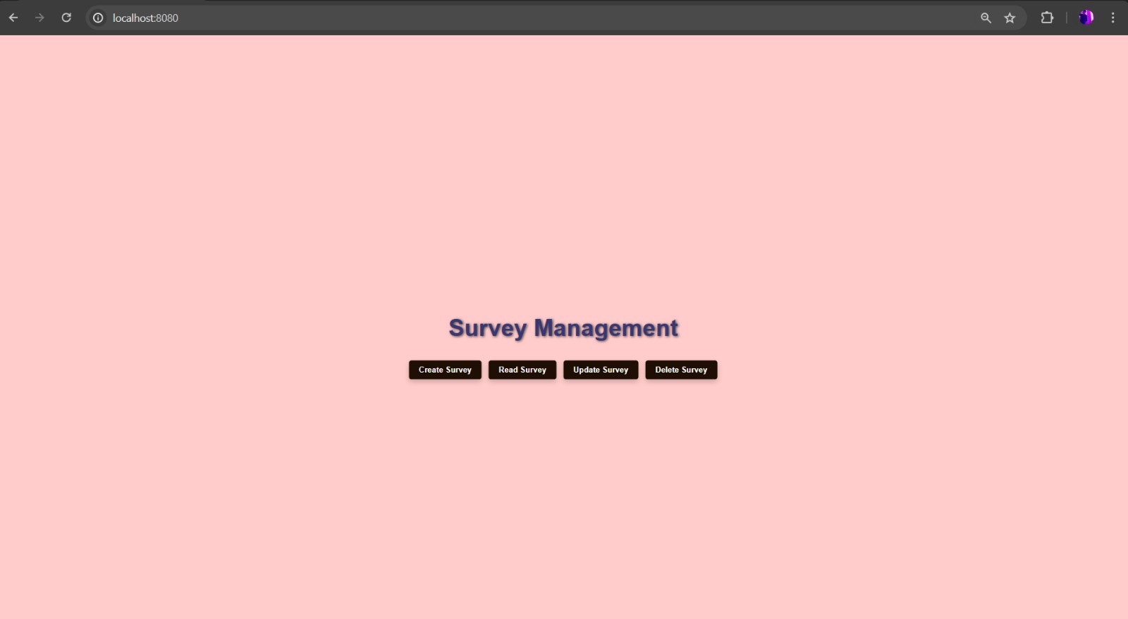
Output/Working of program

Slide 14
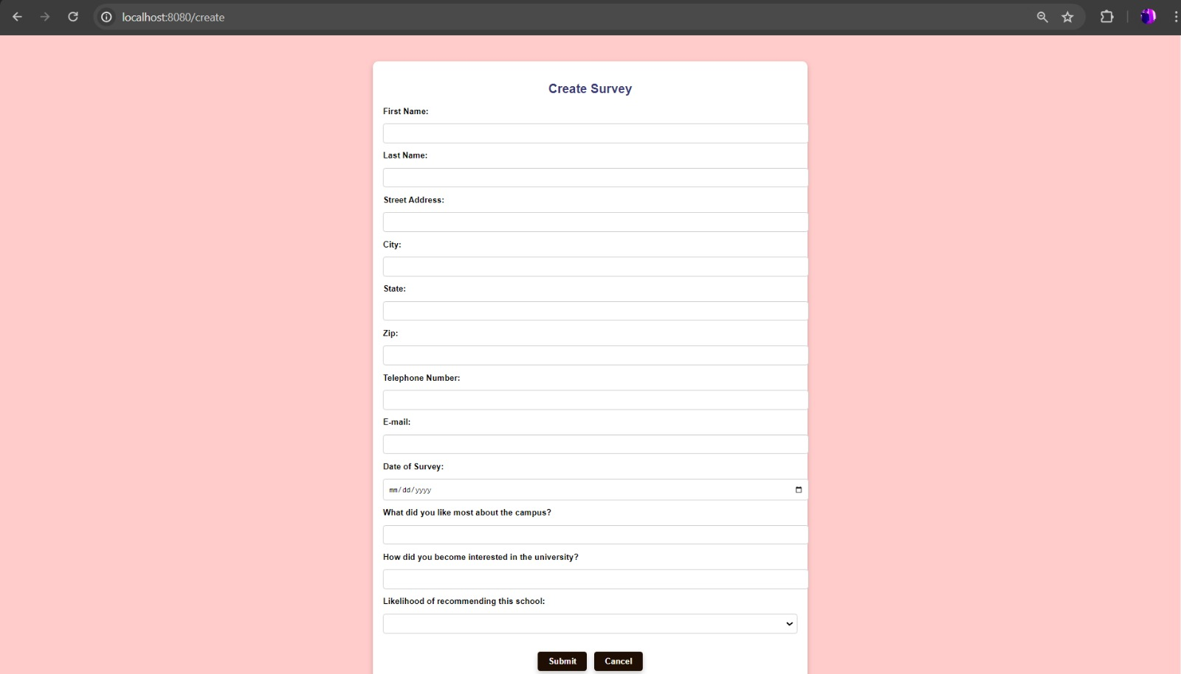

Slide 15
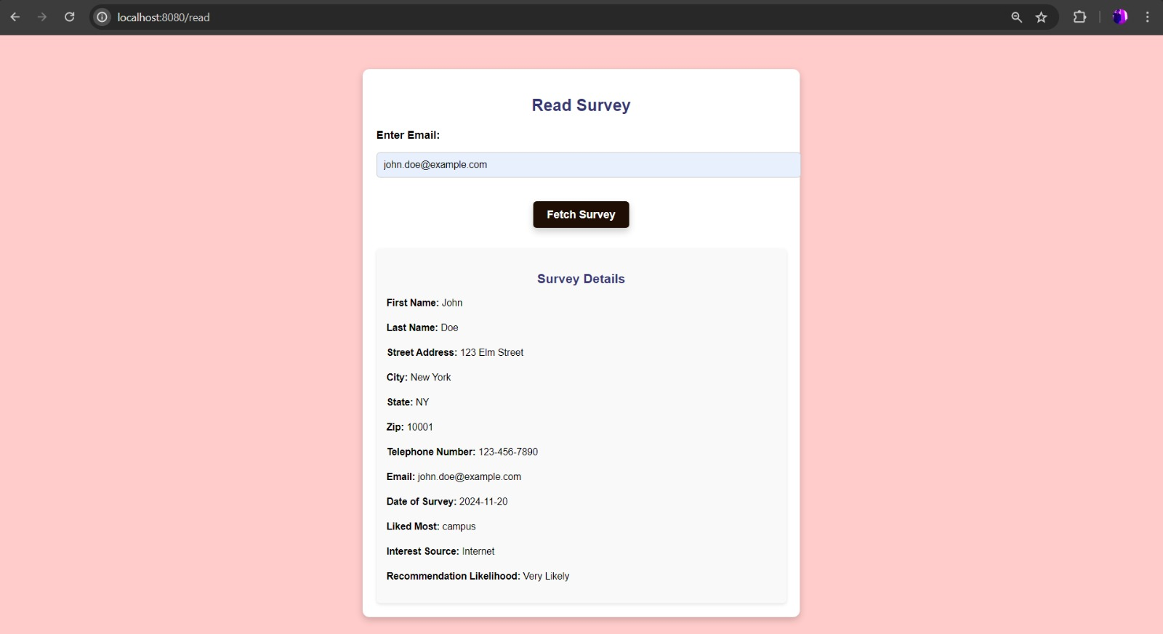

Slide 16
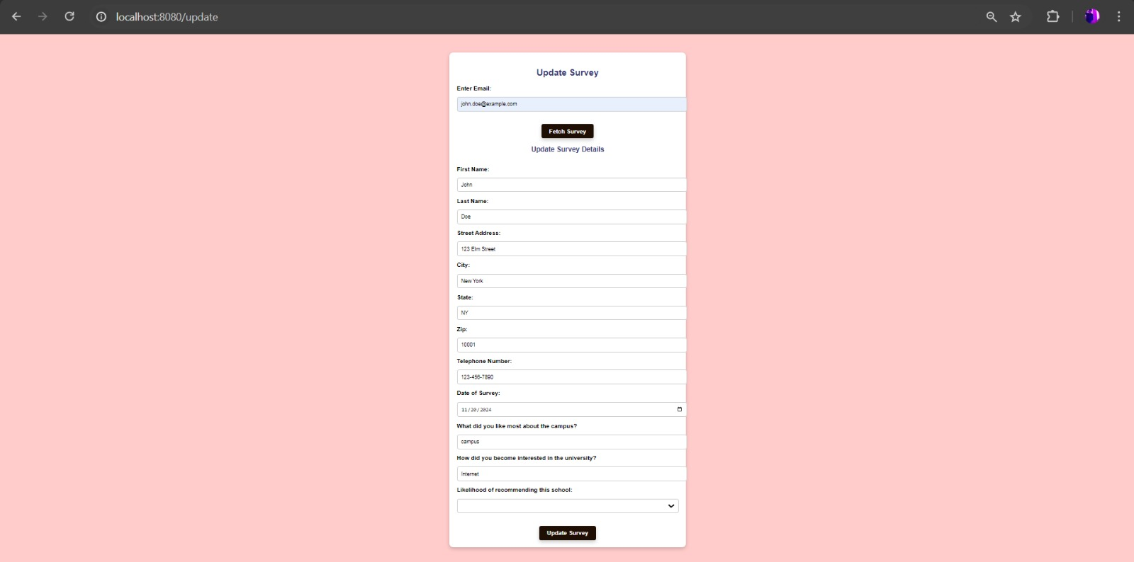

Slide 17
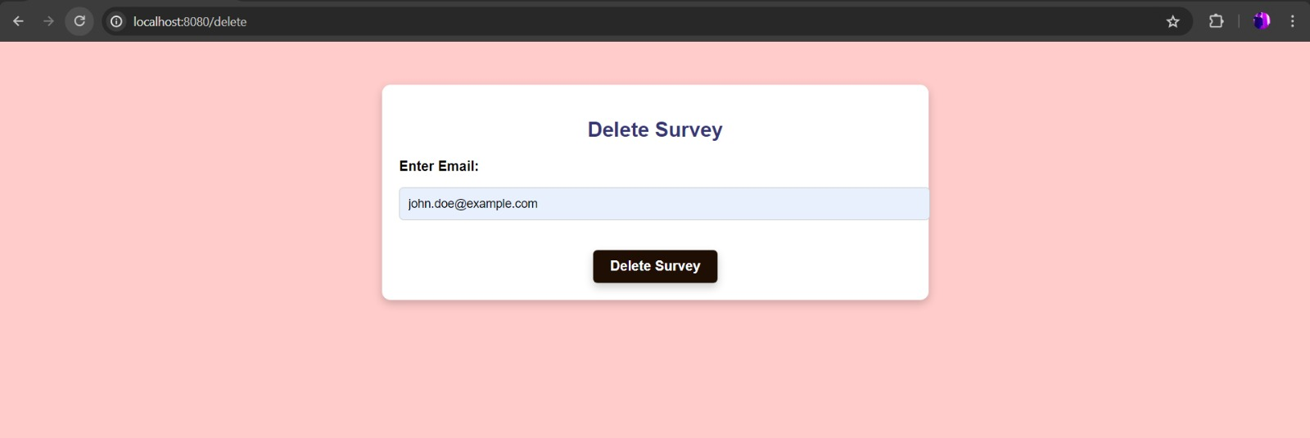

Slide 18
Conclusion
Vue.js stands out as a dynamic and approachable framework for modern web development, combining ease of use with powerful functionality.
Its reactive nature, flexible integrations, and scalability make it suitable for a wide range of applications.
Whether you're building a small project or a complex enterprise application, Vue.js empowers developers to create seamless, interactive user experiences with efficiency and simplicity.
As its community continues to grow, Vue.js remains a reliable and future-ready choice for developers."

Slide 19
References
https://vuejs.org/guide/introduction.html
https://www.w3schools.com/whatis/whatis_vue.asp
https://github.com/vuejs
https://developer.mozilla.org/en-US/docs/Learn/Tools_and_testing/Client-side_JavaScript_frameworks/Vue_getting_started
https://github.com/vuejs/core

